Slide 1
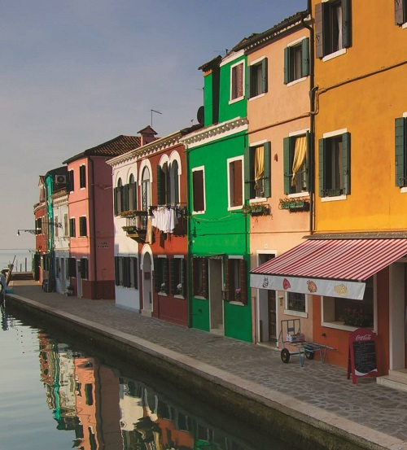


Part I Warm Up
Answer these questions with a partner.
Homes
Look at the photo. Do you like these homes?
Do you live in a house or an apartment?
What’s better: a big house in the country, or a small apartment in the city? Why?
Colorful houses beside the water in Veneto, Italy

Slide 2
Content Note
A typical Italian home is often spread over two, three, or more floors. Sometimes, a bigger house will be shared by more than one family, each living on different floors.
Veneto is the most popular region of Italy for tourists to visit each year. Its cultural and historical heritage is on display in smaller homes such as those in the picture as well as in the grand Palladian villas that are found along the Brenta Riviera.

Slide 3
A home is a place where someone lives regularly. A home can be a range of different dwellings: house, apartment/flat, condo/condominium, townhouse, etc.
Home is often used to refer to the house where you grew up, which is located in your hometown. As an adjective, home can also be found in phrases like home country, home team, and home territory. Something that is home-made is made by hand instead of by machine. The term home can also refer to a person’s upbringing or family: She comes from a good home.

